Slide 1
Event Planner App
EventEase
Turning Chaos into Celebration!

Slide 2
Table of contents
01
02
03
04
Problem
Analysis
The Problem Faced by Event planners
Research of why we Selected this Topic
Solution
Initiatives
Solution of That Problem inform of our App
Social / Economical Initiatives

Slide 3
01
Problem Statement
Whats The biggest Problem For an Event Planner

Slide 4


Biggest Problem Faced by Event Planners
Event planners face significant challenges in managing the complexities of their work, including last-minute changes to venues or guest counts, budget constraints that limit quality, and tight deadlines that complicate task management. Coordinating multiple vendors and balancing client expectations can lead to stress, while guest management—such as tracking RSVPs and seating arrangements—adds to the burden. Additionally, unforeseen technology issues can disrupt events, making effective planning and adaptability crucial for success.

Slide 5
01
Main Objective
Whats The Main Objective of Selecting this project

Slide 6
Main Objective of Event Ease
The main objective of your event planner app is to streamline the event planning process by providing a centralized platform for effective coordination and communication. It aims to simplify budget management, vendor coordination, and guest tracking, reducing stress for planners. Ultimately, the app seeks to enhance the quality of events and allow planners to focus on delivering exceptional experiences.

Slide 7
50%!
We are planning to reduce the load of event planners atleast by 50% even that’s alottt!

Slide 8
02
Reasearch Analysis
Reasearch About Why we Selected it

Slide 9
Identify your target audience
Age
Gender
Young adult: 25-40
Female / Male
Other
Occupation
Why?
What do they do
why do they need it

Slide 10
Who Actually Need our EventEase
Professional Bussinesses
Individuals
Existing Event planners who want to save their money and time by proper planning , Who want to get more Exposure . Event Planning Agency who needs more clients
Who want to make their events special for their Family,Reatives and loved ones ,
Who want to explore the world through a different angle,or plan an event on their own

Slide 11

Personal Analysis
We circulated a survey form within our friends who try to manage birthday parties, Baby showers,or any kind of event in their family on their own
Our recent survey found that 87% of teens consider saving money in event planning while 42% currently have saving behavior.
Percent of Teenagers Wasting resources Instead of Saving(Wasting Money): 7% Saving Money and resource: 35%

Slide 12
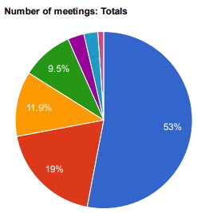
Most popular countries for conferences
United States
Germany
United Kingdom
France
Australia
Canada
Spain
Italy
Netherlands
Singapore
Japan
Switzerland
United Arab Emirates
South Korea

Slide 13
Global Event Destinations
Europe
United Nations Office in Geneva
USA
All big Concerts, Meeting Happen in
India
Rarely we witness a Global Conferrence

Slide 14
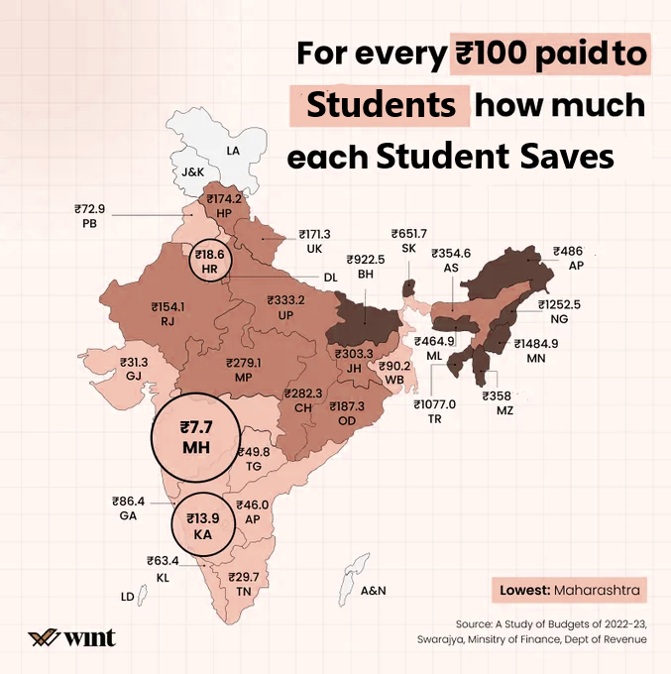
India’s Map In terms of Money Saving
Survey Of Students Spending Money

Slide 15
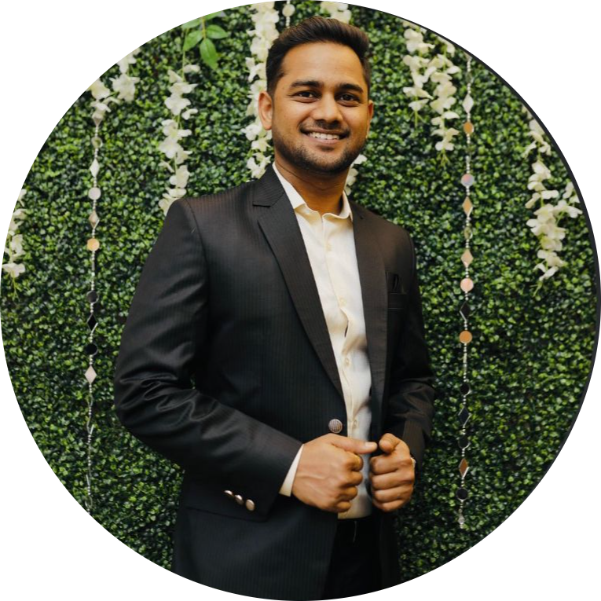

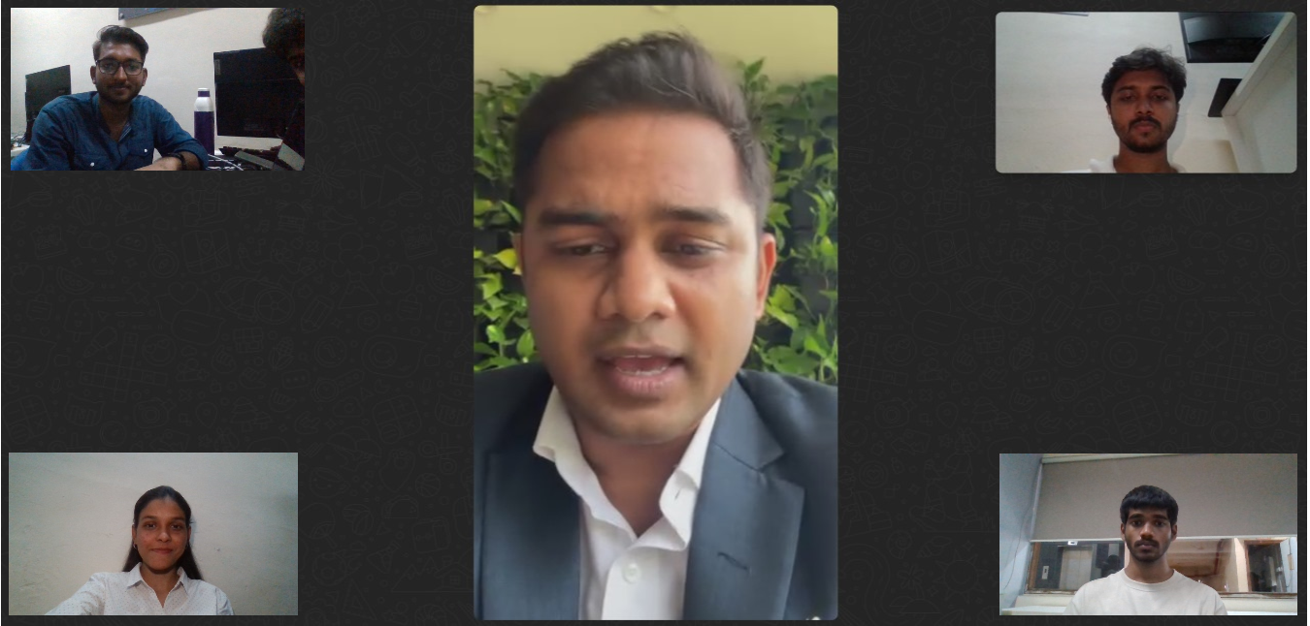
Valuable Insights
Work Profiles : Café Operator , Mexican Outlet Manager at Royal Caribbean and Symphony of Seas
Currently Working as Associate Manager At Lodha Group of Industries
Current Work Place and Task : At Lodha World Towers Renting and providing empaneled vendors for catering and decorations
Mr. Atul Prakash Buran

Slide 16

Questions we focus upon
"How do you prioritize and manage multiple events happening at the same time?“
"What’s your process for handling unexpected challenges during an event? And what’s the biggest Challenge for you ?“
"What key elements do you focus on to ensure a seamless guest experience?“
"How do you collaborate with your team to ensure everyone is aligned and performing efficiently?“
"What trends or innovations do you think are shaping the future of event planning?

Slide 17
How to organise an event
Atul Buran, a former banquet manager on the Royal Caribbean and Symphony of the Seas, specialized in organizing diverse events aboard the world’s largest cruise ships. He mastered the art of event planning by meticulously coordinating logistics, catering, and guest services for each event type, from weddings to corporate gatherings. His approach involved understanding the unique requirements of each event, managing a large team, and ensuring seamless execution in a floating venue. His attention to detail, adaptability to changing environments, and excellent communication skills were key in delivering exceptional guest experiences at sea.
Tips For US
"Organizing events on a cruise ship, especially something as massive as the Symphony of the Seas, is all about flexibility and teamwork. Every event is different—a wedding, a corporate gala, or just a small private party—so you need to be ready for anything. I always start by understanding what the client wants, then work closely with my team to make sure everything is perfect, from food to décor to timing. And remember, things change fast on a ship, so you have to stay calm and think on your feet. It's challenging, but when everything comes together, it's worth it."

Slide 18

Let Us Create Your Core Memories

Slide 19
03. Solution Event Ease

Slide 20
The charity event planning process
Set a budget
How much we Spend Daily
Select a theme
What Type of Work we will Do
Choose a venue
Where Will we do It
Promote the event
Promoting Vendors and Employment

Slide 21
Tech Stack Used
MonogoDb
JS Libraries
Multiple refferencing (3 Schemas are easily Managed )
React.Js ,Node.js , 3.js,e.js
Front End
Python / Security
Html, CSS , Javascript
Email Sender to Vendor, SHA-256 Algorithm

Slide 22
Key Features
01
02
03
04
05
06
E-Planner
AI Assistant
Vendor Alliance
Streamlines scheduling and task management
Automates tasks and offers smart suggestions.
Vendors get National Exposure
Custom Temp
Chatroom
WhatsApp Chatbot
User Friendly for Planner to manage tasks
Facilitates real-time team collaboration.
Enhances communication with guests.

Slide 23
Creative Event Design Ideas
Multilingual
Offline Mode
Event Calendar
Supports Multiple Languages for different users
Any person can access our site without internet services
Gives info about upcoming events nearby

Slide 24
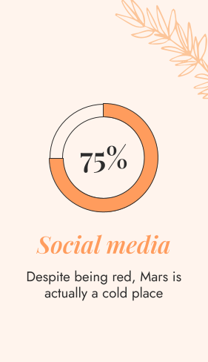
Mobile Responsive
The App Which we have made has a Responsive User Interface Making a

Slide 25
Implementation Plan
01
02
03
04
Creating Apk
Beta App
Launch App
Channel
Creating an Application to be used
Using the Beta App and Testing and Gaining Feedback
Launching Our app on Playstore and App Store
Channel Tells us about event and Festivals

Slide 26

—Lord Krishna in Mahabharta
“Even a small act done with proper planning and forethought can yield great results.”

Slide 27
04
Social/Public Initiatives
The purpose of the event

Slide 28
Impact & Benifits
1. Social Impacts and Benefits :The app fosters community engagement by connecting users with shared interests, promoting collaboration and social interaction. It increases awareness of local events, enhancing the sense of belonging and encouraging participation.
2. Individual Impacts and Benefit s:Users can enhance their organizational and planning skills, leading to personal and professional growth. The app provides personalized tools for efficient time management and fosters networking opportunities.
3. Economic Impacts and Benefits:By promoting local events, the app boosts foot traffic for businesses, contributing to the local economy. It offers cost-effective solutions for budgeting and supports local entrepreneurs by featuring their services.

Slide 29
Creative Coders Team
01
02
03
04
Harshit Chauhan
Ameya Shelar
Front End
Backend
Konisha Thakare
Priyanshu Thombare
FrontEnd
Facilitates real-time team collaboration.

Slide 30
ThankYou
We wish you a very Happy………………

Slide 31
Any Question ?
Regarding our App, Research and Tech Stack Used?

Slide 32
The event planning cycle
Planning
Promotion
Mars is actually a very cold place
Venus has extremely high temperatures
Post-event
At-event
Mercury is the closest planet to the Sun
Saturn is a gas giant and has several rings

Slide 33
Strategic fundraising plan
Strategy | Goal | Action | Staff | When | Expenses
 | $4,200 | Mars is a very cold planet | Mars is made of basalt | 06/02 | $2,000
 | $5,000 | Jupiter is a gas giant | Jupiter is a big planet | 06/05 | $3,100
 | $6,000 | Saturn is a gas giant | Saturn is the ringed planet | 06/10 | $5,250
01
02
03

Slide 34
Contents of this template
This is a slide structure based on a multi-purpose presentation
You can delete this slide when you’re done editing the presentation
Fonts | To view this template correctly in PowerPoint, download and install the fonts we used
Used and alternative resources | An assortment of graphic resources that are suitable for use in this presentation
Thanks slide | You must keep it so that proper credits for our design are given
Colors | All the colors used in this presentation
Icons and infographic resources | These can be used in the template, and their size and color can be edited
Editable presentation theme | You can edit the master slides easily. For more info, click here
For more info: Slidesgo| Slidesgo School | FAQs
You can visit our sister projects: Freepik | Flaticon | Storyset | Wepik| Videvo

Slide 35
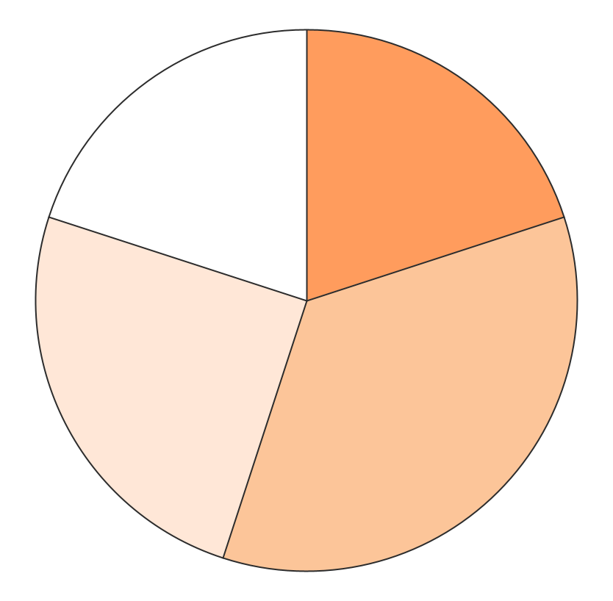
Promotion channels
25%
20%
Invitations
Print ads
Despite being red, Mars is a cold place
Venus has extremely high temperatures
20%
35 %
Website
Social media
Mercury is the closest planet to the Sun
Saturn is a gas giant and has several rings
Follow the link in the graph to modify its data and then paste the new one here. For more info, click here

Slide 36
Resources
Did you like the resources on this template? Get them for free at our other websites:
Vectors
Engraving hand drawn floral pattern
Wedding planner
Events
Timeline
Charity
Welcome
Boxing day
Festivities
Photos
Close up volunteers with food donations
Medium shot people with food donations
Couple making plans for renovating house using laptop and color palette
Medium shot senior man with crossed arms

